Slide 1
C# .NET

Slide 2
C# Introduction
It Was developed by the Microsoft Corporation.
It is high level programming language.
It is an object-oriented programming language.
It is case sensitive programming language.
It extension .cs.
It is a very easy programming language.
It belongs to C family.
It is used to develop various types applications.
Console,Windows,Web and Mobile applications.

Slide 3
Keywords

Slide 4
Data Types keywords
In C# we use predefined keywords which have some meaning in the program , they can’t be used as variables names, class names, methods names.
Bool byte char decimal
Double float int long
Object sbyte short
String uint ulong ushort
Void dynamic nint nuint

Slide 5
Class and Object Keywords
class
struct
interface
enum
record
new
this
base

Slide 6
Method and Property Keywords
virtual
override
abstract
sealed
static
readonly
const
extern
partial
async
await

Slide 7
Exception Handling Keywords
try
catch
finally
Throw
Miscellaneous Keywords
operator
implicit
explicit
delegate
event
Lock Fixed unsafe stackalloc volatile
Default null true false

Slide 8
Namespaces
namespace
using
Global
Parameter Keywords
ref
out
in
params

Slide 9
Control Flow Keywords
if
else
switch
case
default
for
foreach
while
do
break
continue
Goto return yield

Slide 10
Type Conversion Keywords
is
as
typeof
sizeof
checked
unchecked

Slide 11
Identifiers
Identifier refers to variables name, methods names, class names, namespace names , enum names, Structure names.
We can’t use predefined keywords of C# , because they have some meaning the program.
We can give our names which will have some meaing.
These variables names or methods name or class names or namespace must follow naming convention.

Slide 12
Name conventions
There are three types naming conventions
Pascal case Naming convention
Camel Case naming convention
Snake Case naming convention

Slide 13
Pascal Case Naming Convention
A Pascal case naming convention is convention in which first letter starts with Capital and Rest letters can be Lower Case , when new Words starts Again Upper case and then lower case.
This naming convention can be used for
Classe names
Methods names
Namespace Names
Structure Names
Property Names
Examples :
FirstClass , MyClass , MySystem

Slide 14
Camel Case and Snake Case Naming convention
This naming convention can be applied for only variables names.
string firstName; // camel case
String first_name; // snake case

Slide 15
C# Program Structure
Predefined Namespaces
User defined Namespace
Class Declaration
Data types
Methods.

Slide 16
Structure Definitions
Namespace
It is set of classes,interfaces,enumerations,deligates etc….
Class
It is the collection of datatypes and methods.

Slide 17
C# Program Structure
using System;
using System.Collections.Generic;
using System.Linq;
using System.Text;
namespace Test {
class Program
{
static void Main(string[] args)
{
}
}
}
Predefined Namespaces
User defined Namespace
Class Declaration
Method
Document Area

Slide 18
How to develop a program in C#?
Open the project
Code the program using C#.
Execute using Ctrl+F5.
These Steps will be repeated for all the programs.

Slide 19
Visual Studio Introduction
It is an IDE(Integrated Development Environment).
It is used develop software , web and Mobile applications.
It is Introduced by Microsoft.
In order to work with any project in Visual Studio tool we need know about Solution Explorer and Server Explorer .
Solution Explorer in which project and its respect files can be added.
Sever Explorer in which Databases can deal the with the DataBases.

Slide 20
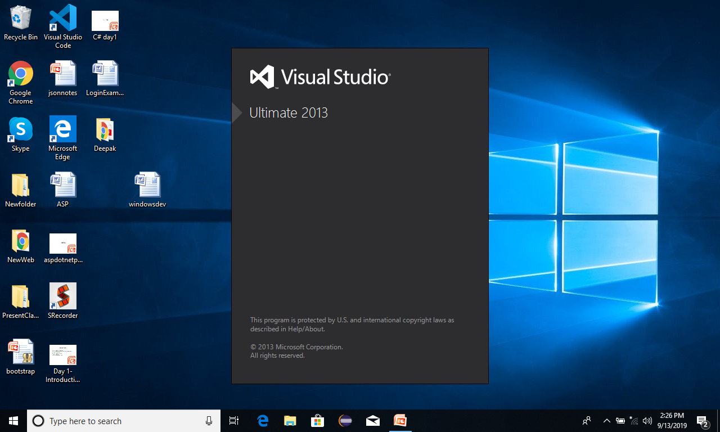
Creating new project in VS

Slide 21
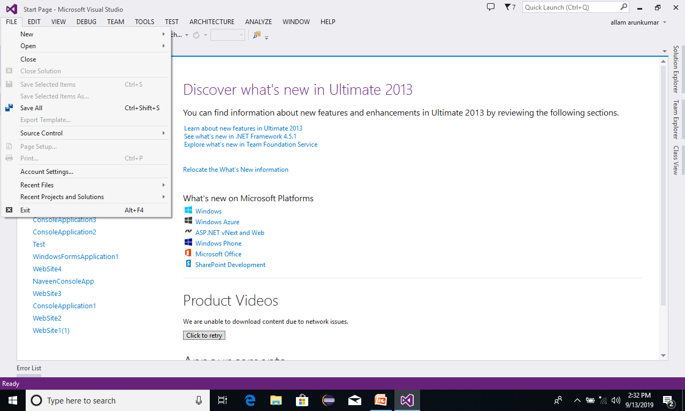
Creating new project in VS

Slide 22

Creating new project in VS

Slide 23
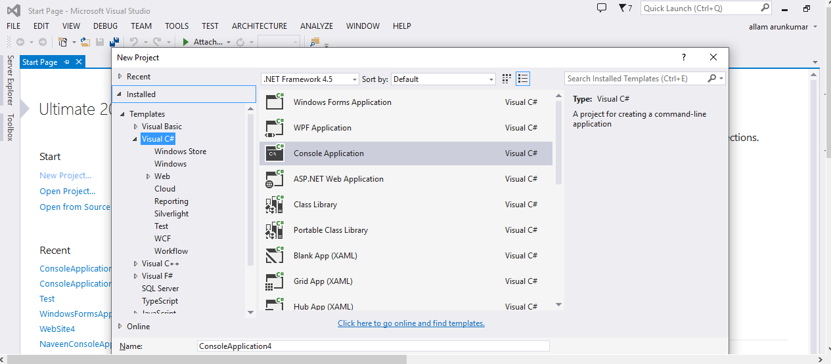
Creating new project in VS
Programming language
Application Type
Application Name

Slide 24
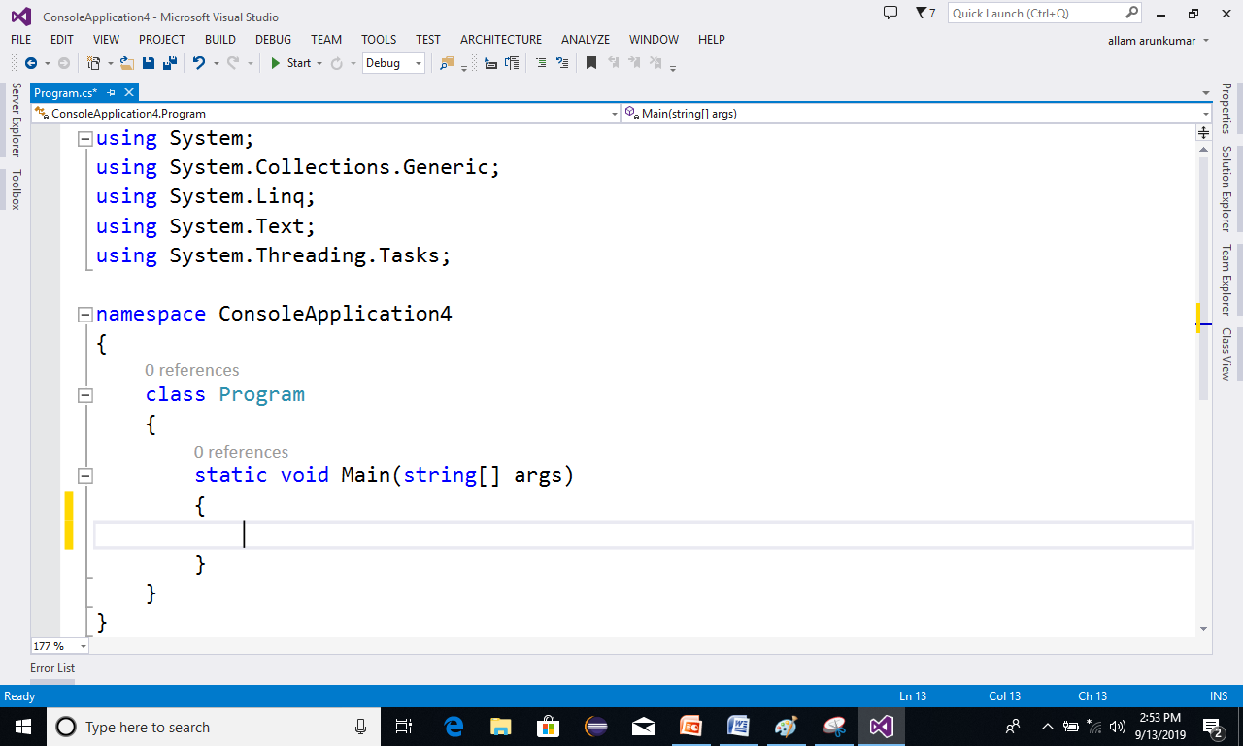
Coding new program in VS

Slide 25
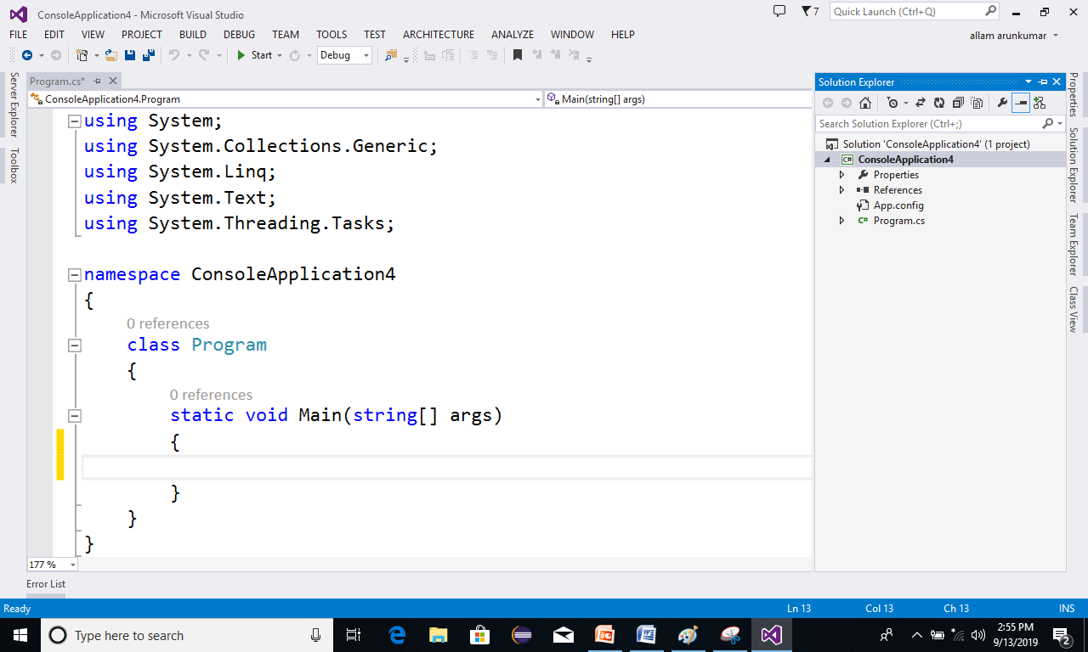
Coding new program in VS
Solution Explorer in which,
we Add Files to the project,
all the files which are present project will be seen here
Document Area where work here

Slide 26
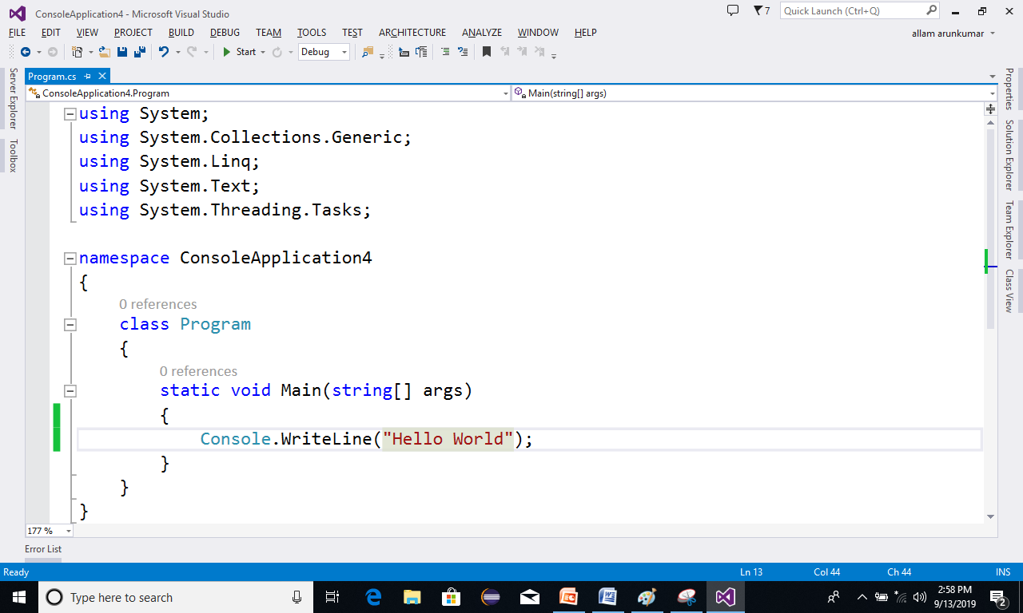
Coding new program in VS
After writing the code
press CTRL + F5
To
Execute the Program

Slide 27
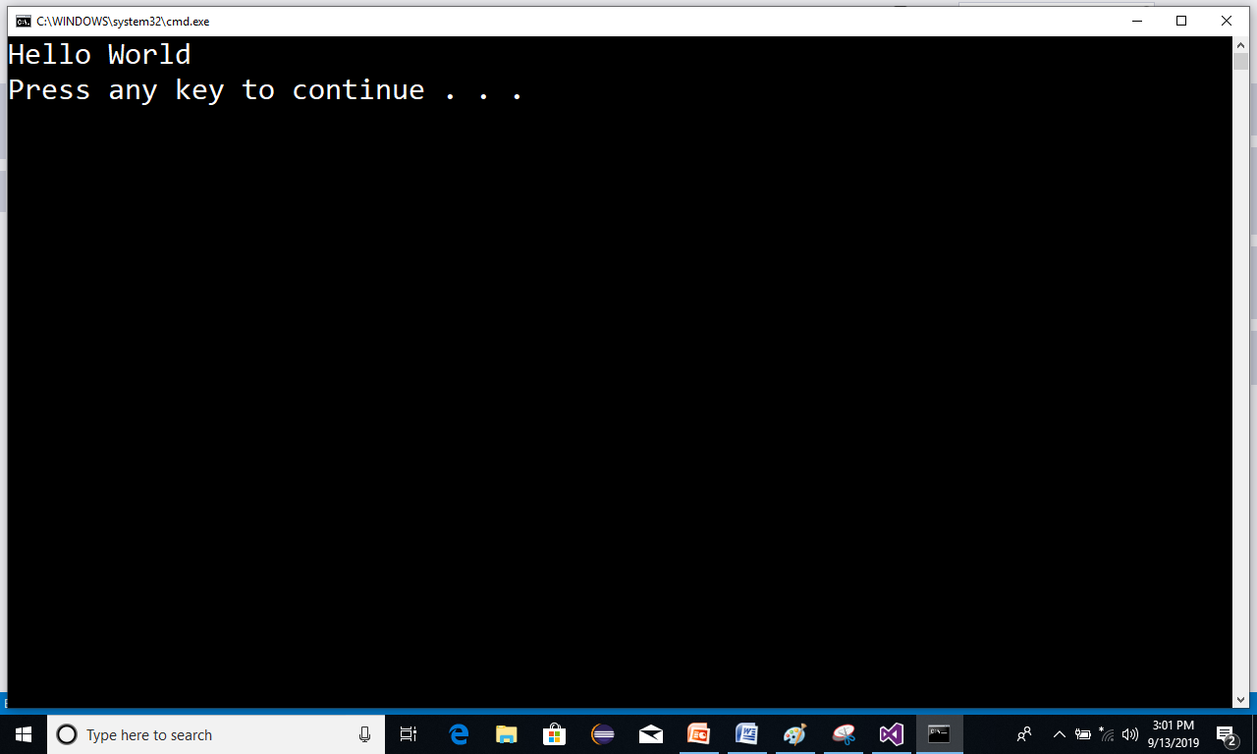
Coding new program in VS
After Executing the project We get
out put.

Slide 28
Data Types in C#
char 1 byte
int 4 byte
float 4 byte
double 8 byte
decimal 16 byte
String
Class
Bool - 1byte
Byte - 1byte
Sbyte - 1byte
Short - 2bytes
Ushort – 2bytes
Long - 8 bytes
Ulong- 8 bytes

Slide 29
Input and Out Put Methods
Out put Methods
These methods can be used to display the statements and values inside the console App.
They are
Console.WriteLine()
Console.Write()

Slide 30
Input and Out Put Methods
Input Methods
These are used to read values from the console.
Tyey are
Console.ReadLine()
Console.Read()
Console.ReadKey()

Slide 31
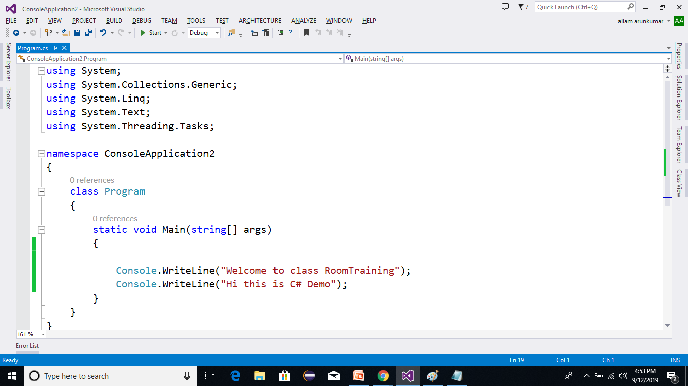
Example on out put methods

Slide 32
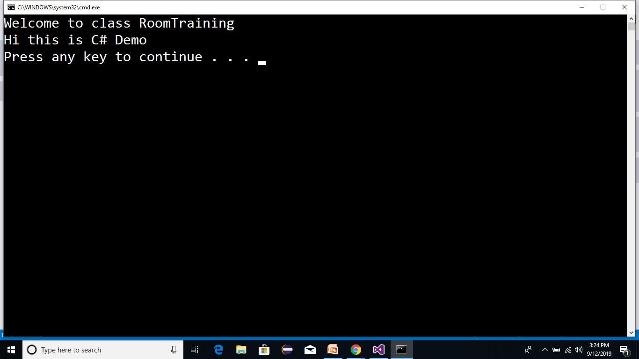
Coding new program in VS
After Executing the project We get
out put.

Slide 33
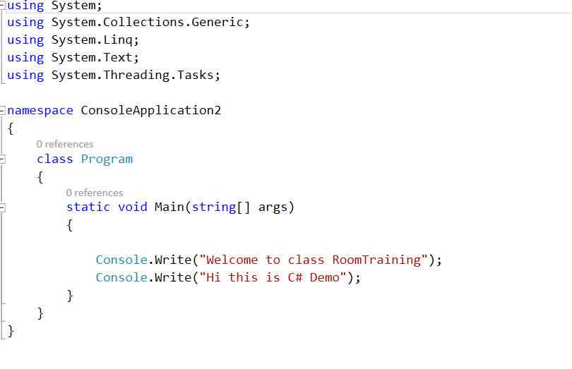
Example on out put methods

Slide 34
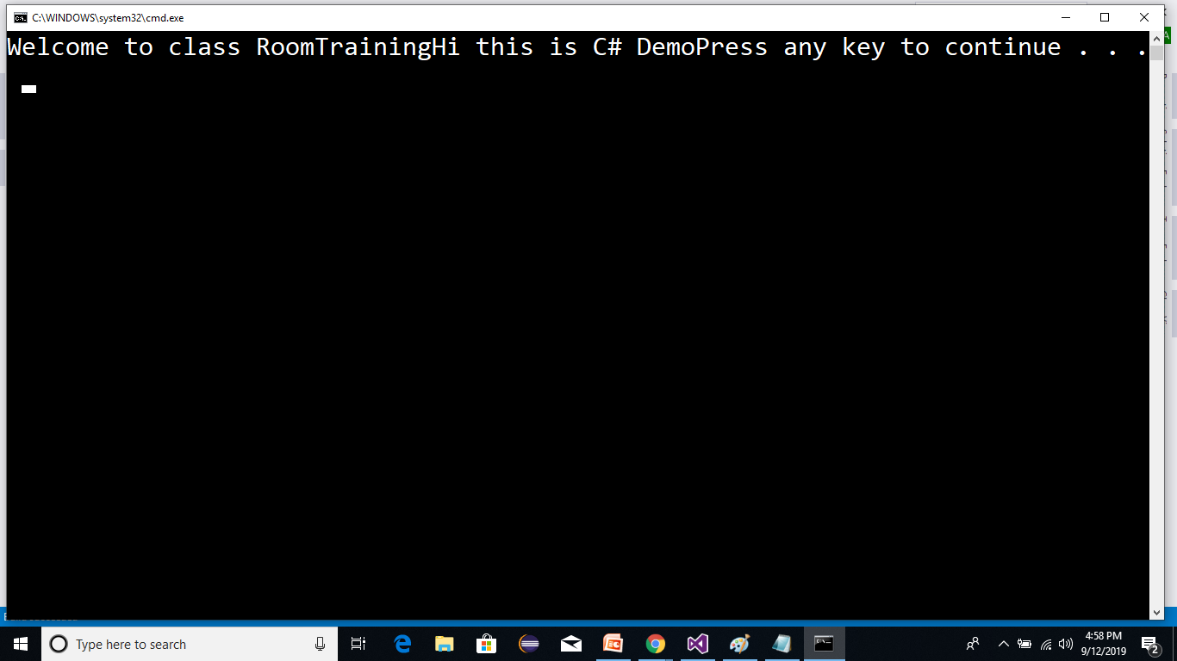
After Executing VS
After Executing the project We get
out put.

Slide 35
Example on Data Types with Out put methods
static void Main(string[] args)
{
int a = 10;
float x = 4.5f;
double d = 7.8;
string s = "Welcome";
decimal m = 5.6m;
Console.WriteLine("{0} {1} {2} {3} {4}",a,x,d,s,m);
}

Slide 36
Input and Out Put Methods
Input Methods
These are used to read values from the console.
Tyey are
Console.ReadLine()
Console.Read()
Console.ReadKey()

Slide 37
Input and Out Put Methods
Console.ReadLine()
It is used to read a string
Int.Parse(Console.ReadLine())
It is used to Read Integer Value
Float.Parse(Console.ReadLine())
It is used to Read Float value.
Double.Parse(Console.ReadLine())
It is used to Read double value.
Bool.Parse(Console.ReadLine())
It is used to boolean value
Console.Read()
It used to Read ASCII Value of the given Character.
Console.ReadKey()
It is used to read a key from the console

Slide 38
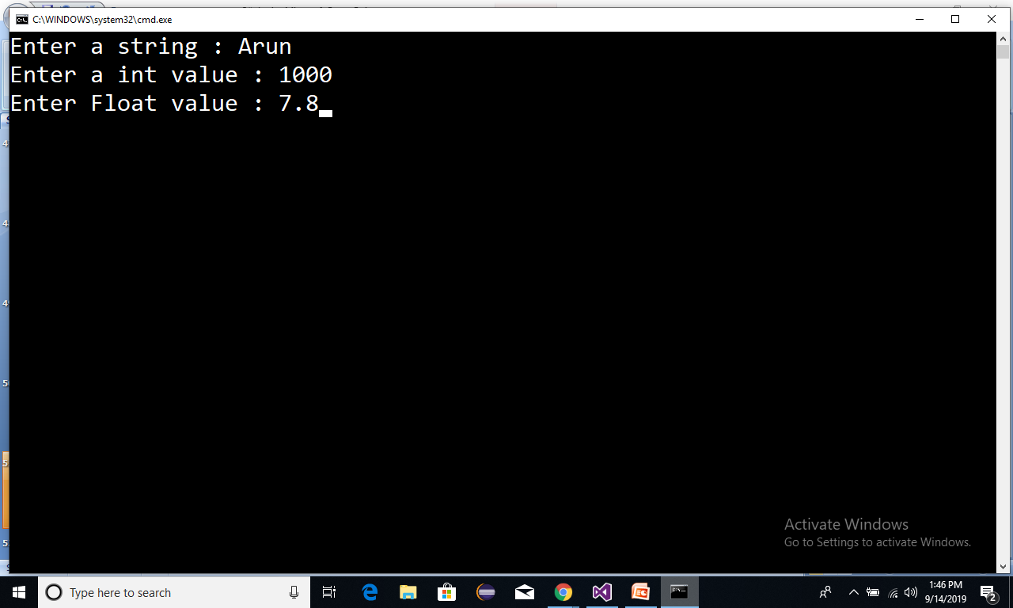
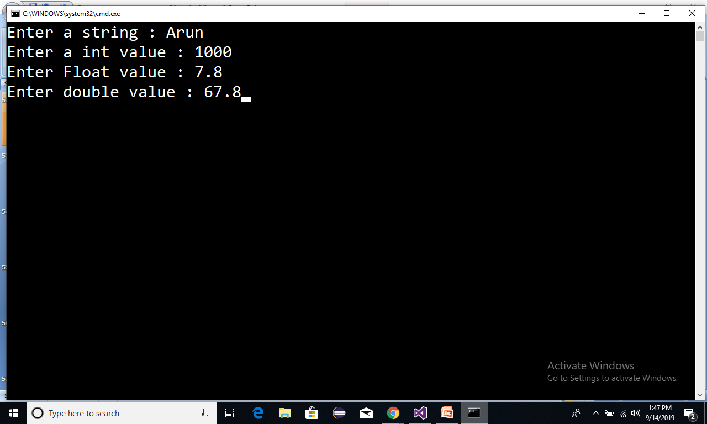
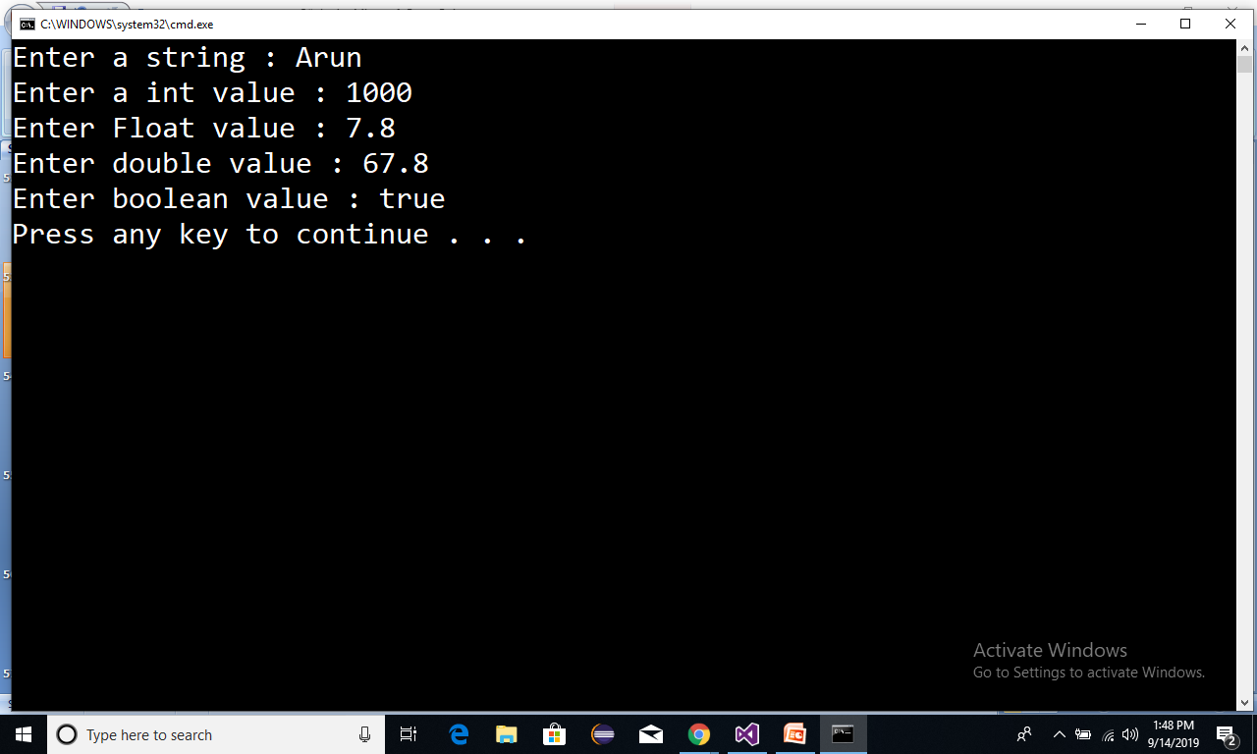
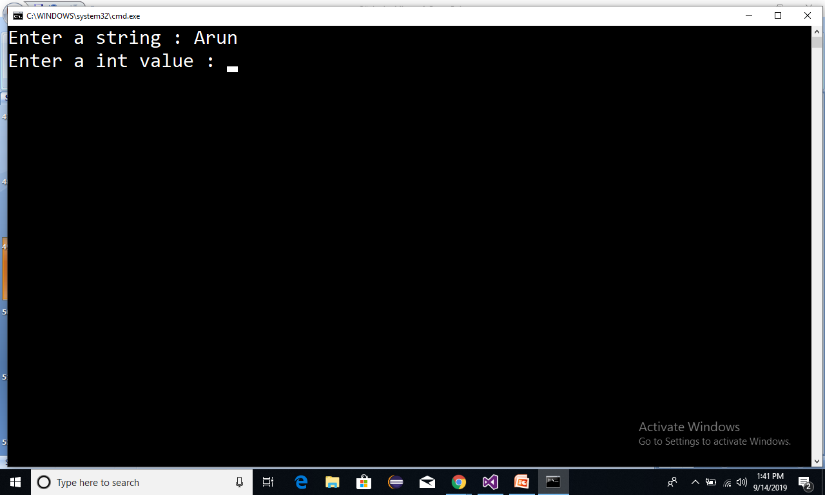

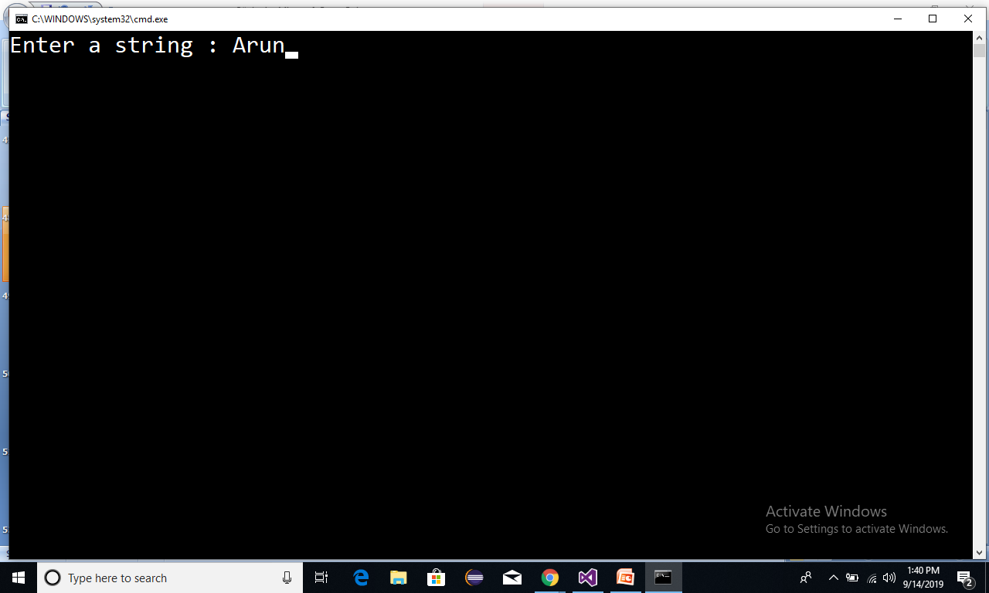
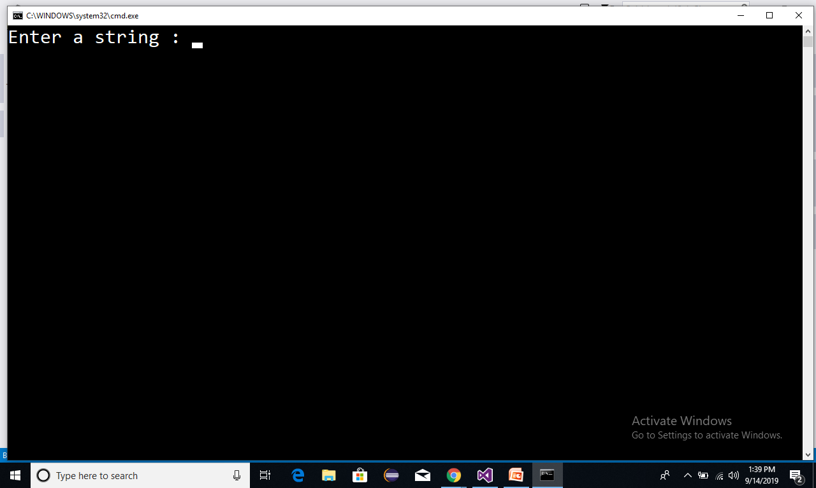
Reading values
static void Main(string[] args)
{
Console.Write("Enter a string : ");
string s = Console.ReadLine();
Console.Write("Enter a int value : ");
int a = int.Parase(Console.ReadLine());
Console.Write("Enter Float value : ");
float f =float.Parse(Console.ReadLine());
Console.Write("Enter double value : ");
double d =double.parse(Console.ReadLine());
Console.Write("Enter boolean value : ");
bool b =bool.Parse( Console.ReadLine());
}

Slide 39
Operators
Operators
In
C#

Slide 40
Operators in C#
Arithmetic operators .
Relational operators(Comaprision Operator).
Logical Operators.
Assignment operators.
conditional operators.
Increment and Decrement operators.
Bitwise Operators.// home work

Slide 41
Arithmetic operators .
+ -> add
- ->sub
* ->mul
/ ->div-->quo 5/2 ---> 2
% ->mode->Rem 5%2 --->1

Slide 42
Conditional operators
? : (Ternary Operator)
con? Stmt1 : stmt2;
con-->True--->stmt1 can be executed
con--->False-->stmt2 can be executed

Slide 43
Arithmetic operators .
static void Main(string[] args)
{
int a = 5;
int b = 2;
Console.WriteLine("Sum:{0}",a+b);
Console.WriteLine("Sub:{0}",a-b);
Console.WriteLine("Mul:{0}",a*b);
Console.WriteLine("Quo:{0}",a/b);
Console.WriteLine("Rem:{0}",a%b);
}
Sum : 7
Sub : 3
Mul : 10
Quo : 2
Rem: 1

Slide 44
Relational operators:
> ->Greter
< ->less
>= ->Greaterthan or equal
<= ->Lesserthan or equal
== ->(comparision)
!= ->(Not Equal)

Slide 45
Relational operators
static void Main(string[] args)
{
int a = 5;
int b = 2;
Console.WriteLine("a > b : {0}", a > b);
Console.WriteLine("a >= b : {0}", a >= b);
Console.WriteLine("a < b : {0}", a < b);
Console.WriteLine("a <= b : {0}", a <= b);
Console.WriteLine("a == b : {0}", a == b);
Console.WriteLine("a != b : {0}", a != b);
}
a > b:True
a >= b :True
a < b : False
a <= b : False
a == b : False
a != b :True

Slide 46
Logical Operators
&&- --> and
|| ---> or
! ---> not
con1 con2 con1 && con2
true true true
true false false
false true false
false false false
con1 con2 con1 || con2
true true true
true false true
false true true
false false false
con !con
true false
false true

Slide 47
Assignment operators
= Assignment operator
+= Additive Assignment
-= Subtractive Assignment
*= Multiplicative Assignment
/= Division Assignment

Slide 48
Assignment Operators program
static void Main(string[] args)
{
int a = 10;
int b = 20;
Console.WriteLine("a = {0}",a);
a += b; // a = a+b
Console.WriteLine("a = {0}", a);
a -= b;
Console.WriteLine("a = {0}", a);
a *= b;
Console.WriteLine("a = {0}", a);
a /= b;
Console.WriteLine("a = {0}", a);
}
a = 10
a = 30
a = 10
a = 200
a = 10

Slide 49
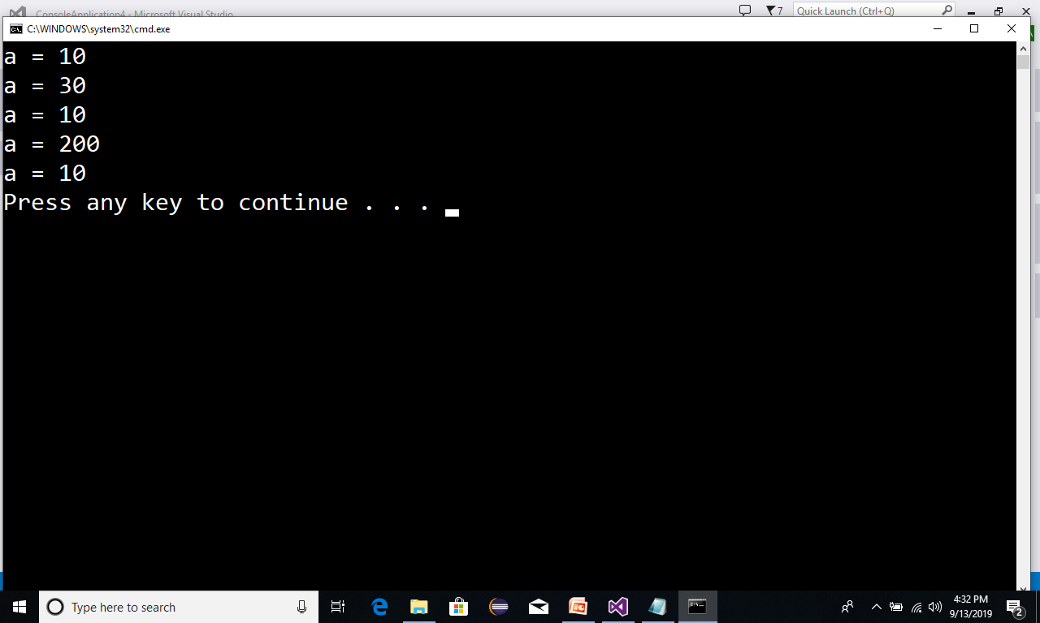
Assignment operators:

Slide 50
Conditional Operators program
static void Main(string[] args)
{
bool con = true;
Console.WriteLine(con?"Hi":"Bye");
}
Hi

Slide 51
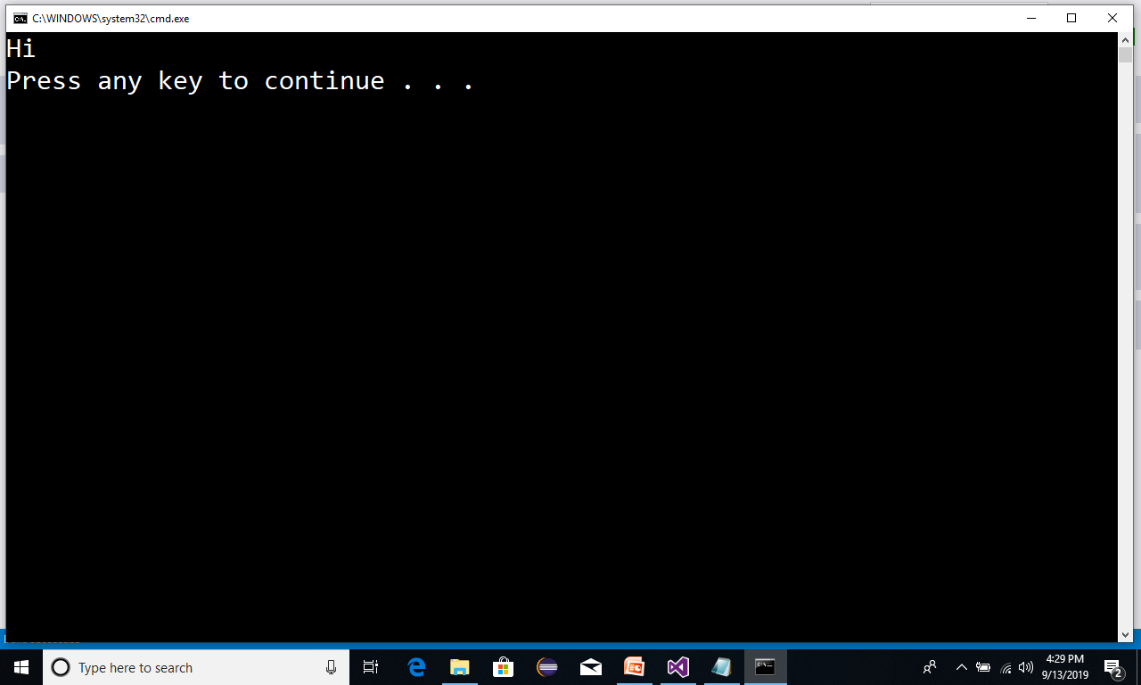
Conditional operators:

Slide 52
Conditional Operators program
static void Main(string[] args)
{
bool con = false;
Console.WriteLine(con?"Hi":"Bye");
}
Bye

Slide 53
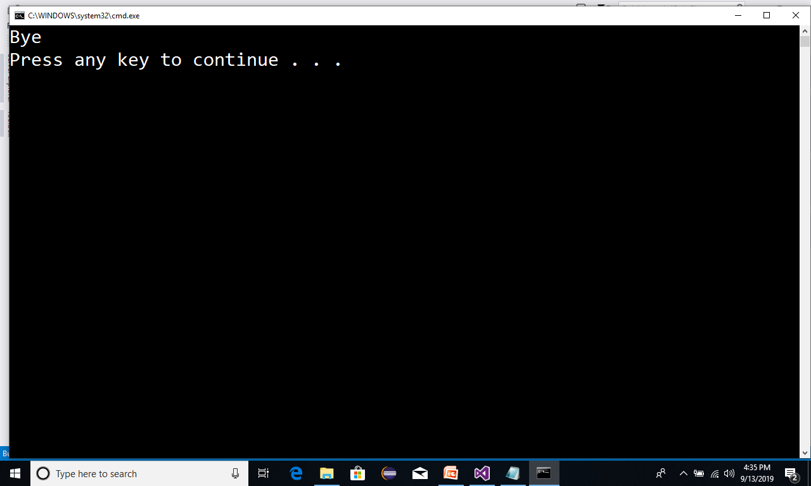
Conditional operators:

Slide 54
Increment and Decrement operators
++ Increment Operator
-- Decrement Operator

Slide 55
Increment and Decrement Operators program
static void Main(string[] args)
{
int a = 10;
int b = 20;
Console.WriteLine("a = {0}",a++); // Post Increment
Console.WriteLine("a = {0}", a);
Console.WriteLine(“b = {0}", ++b); // Pre Increment
Console.WriteLine(“b = {0}", b);
}
a = 10
a = 11
a = 21
a = 21

Slide 56
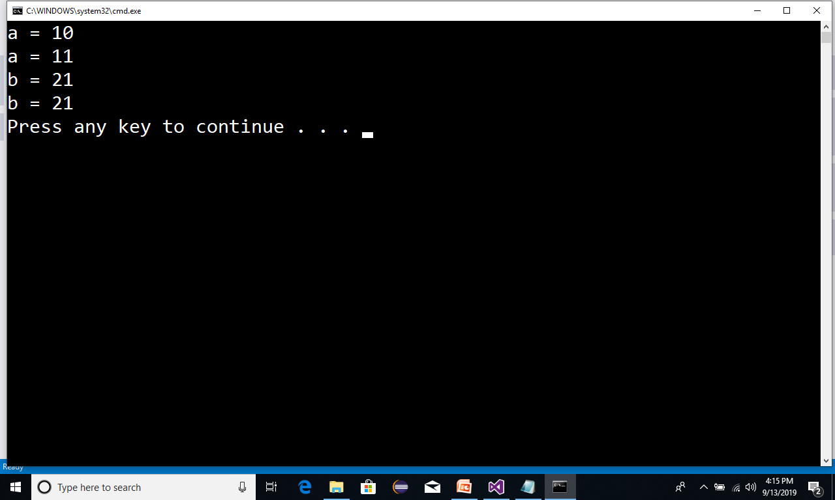
Increment decrement operators:

